Slide 1
RoomNet – a ConvNet to classify real-estate pictures
Souham Biswas

Slide 2
Classification Labels
Following are the class labels with their numeric IDs used to build this neural net –
Backyard – 0
Bathroom – 1
Bedroom – 2
Frontyard – 3
Kitchen – 4
LivingRoom – 5

Slide 3
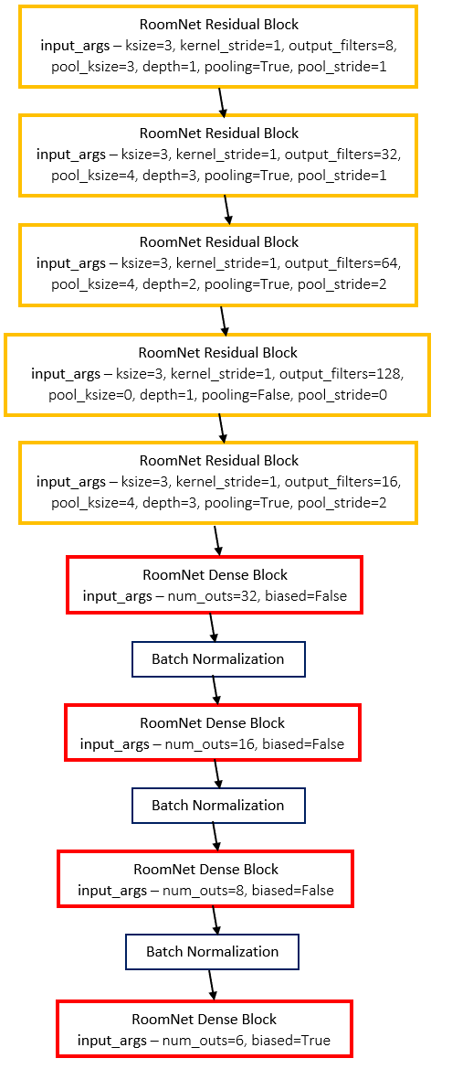
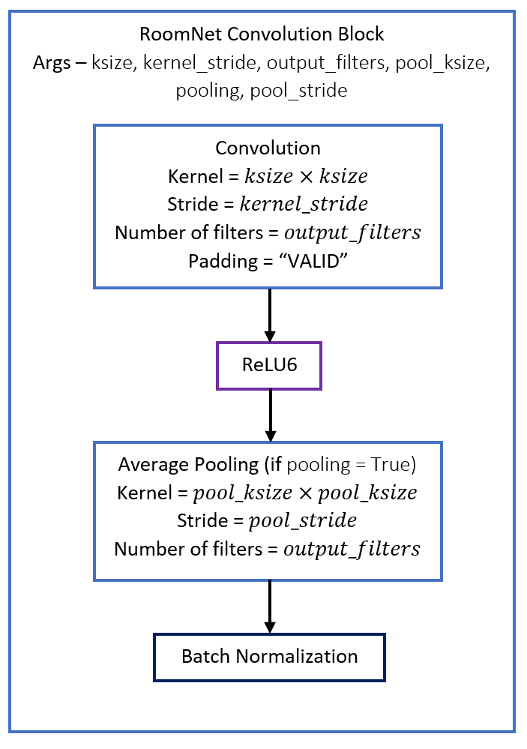
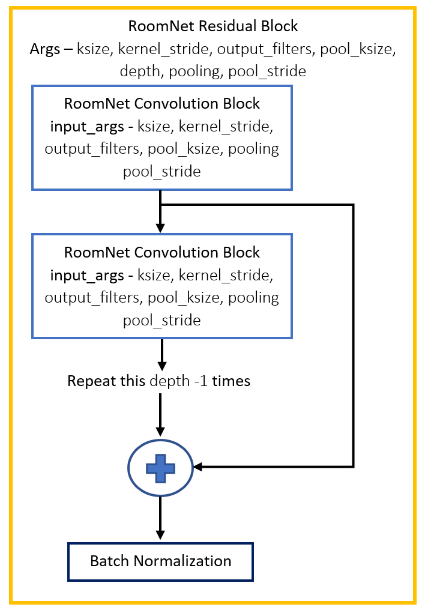
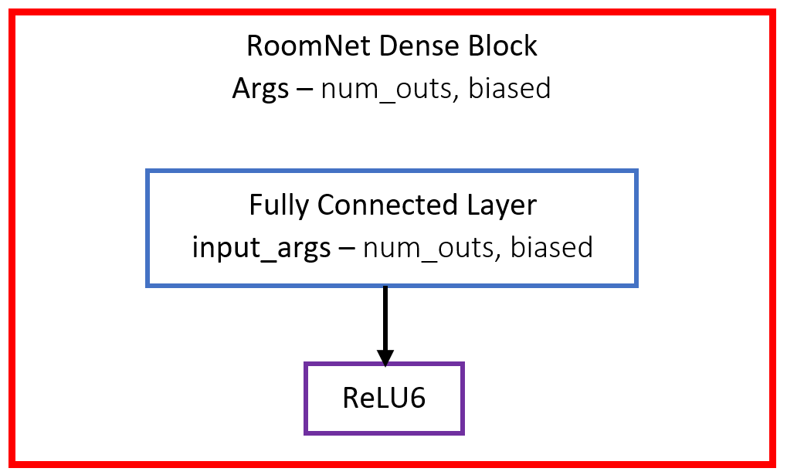
RoomNet Architecture

Slide 4
Training Process
Input image size = 224 x 224 (tried 300 x 300, 600 x 600)
Softmax Cross Entropy Loss used with L2 Weight normalization
Dropout varied from 0 (initially) to 0.3 (intermittently near the end of training). Dropout layers placed after every block.
Batch Normalization moving means & vars were frozen when being trained with dropout
Adam Optimizer used with exponential learning rate decay.
Initially trained with in-batch computation of BatchNorm moving means/vars. Followed this by training net, by disabling this computation and using frozen means/vars during training. Resulted in 10% immediate jump in validation accuracy.
Batch Size varied from 8 (in the beginning) to 45 (towards training end) as – 8 -> 32 -> 40 -> 45

Slide 5
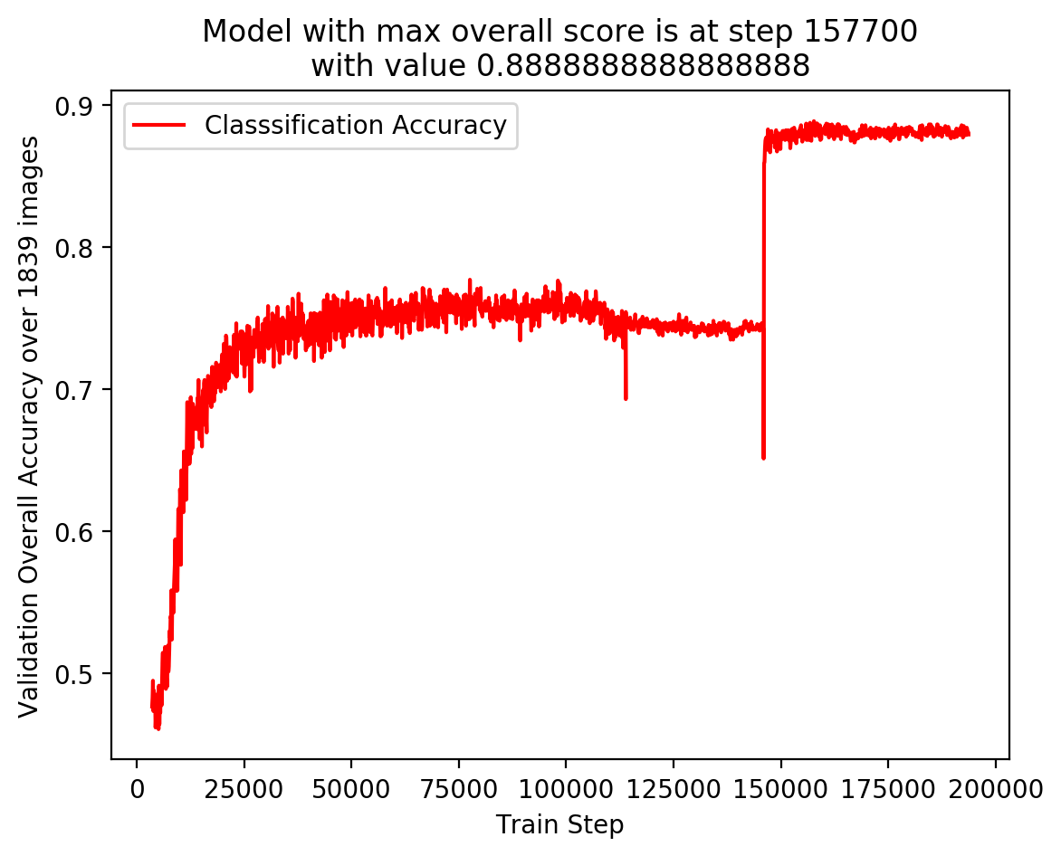
Validation Accuracy plot

Slide 6
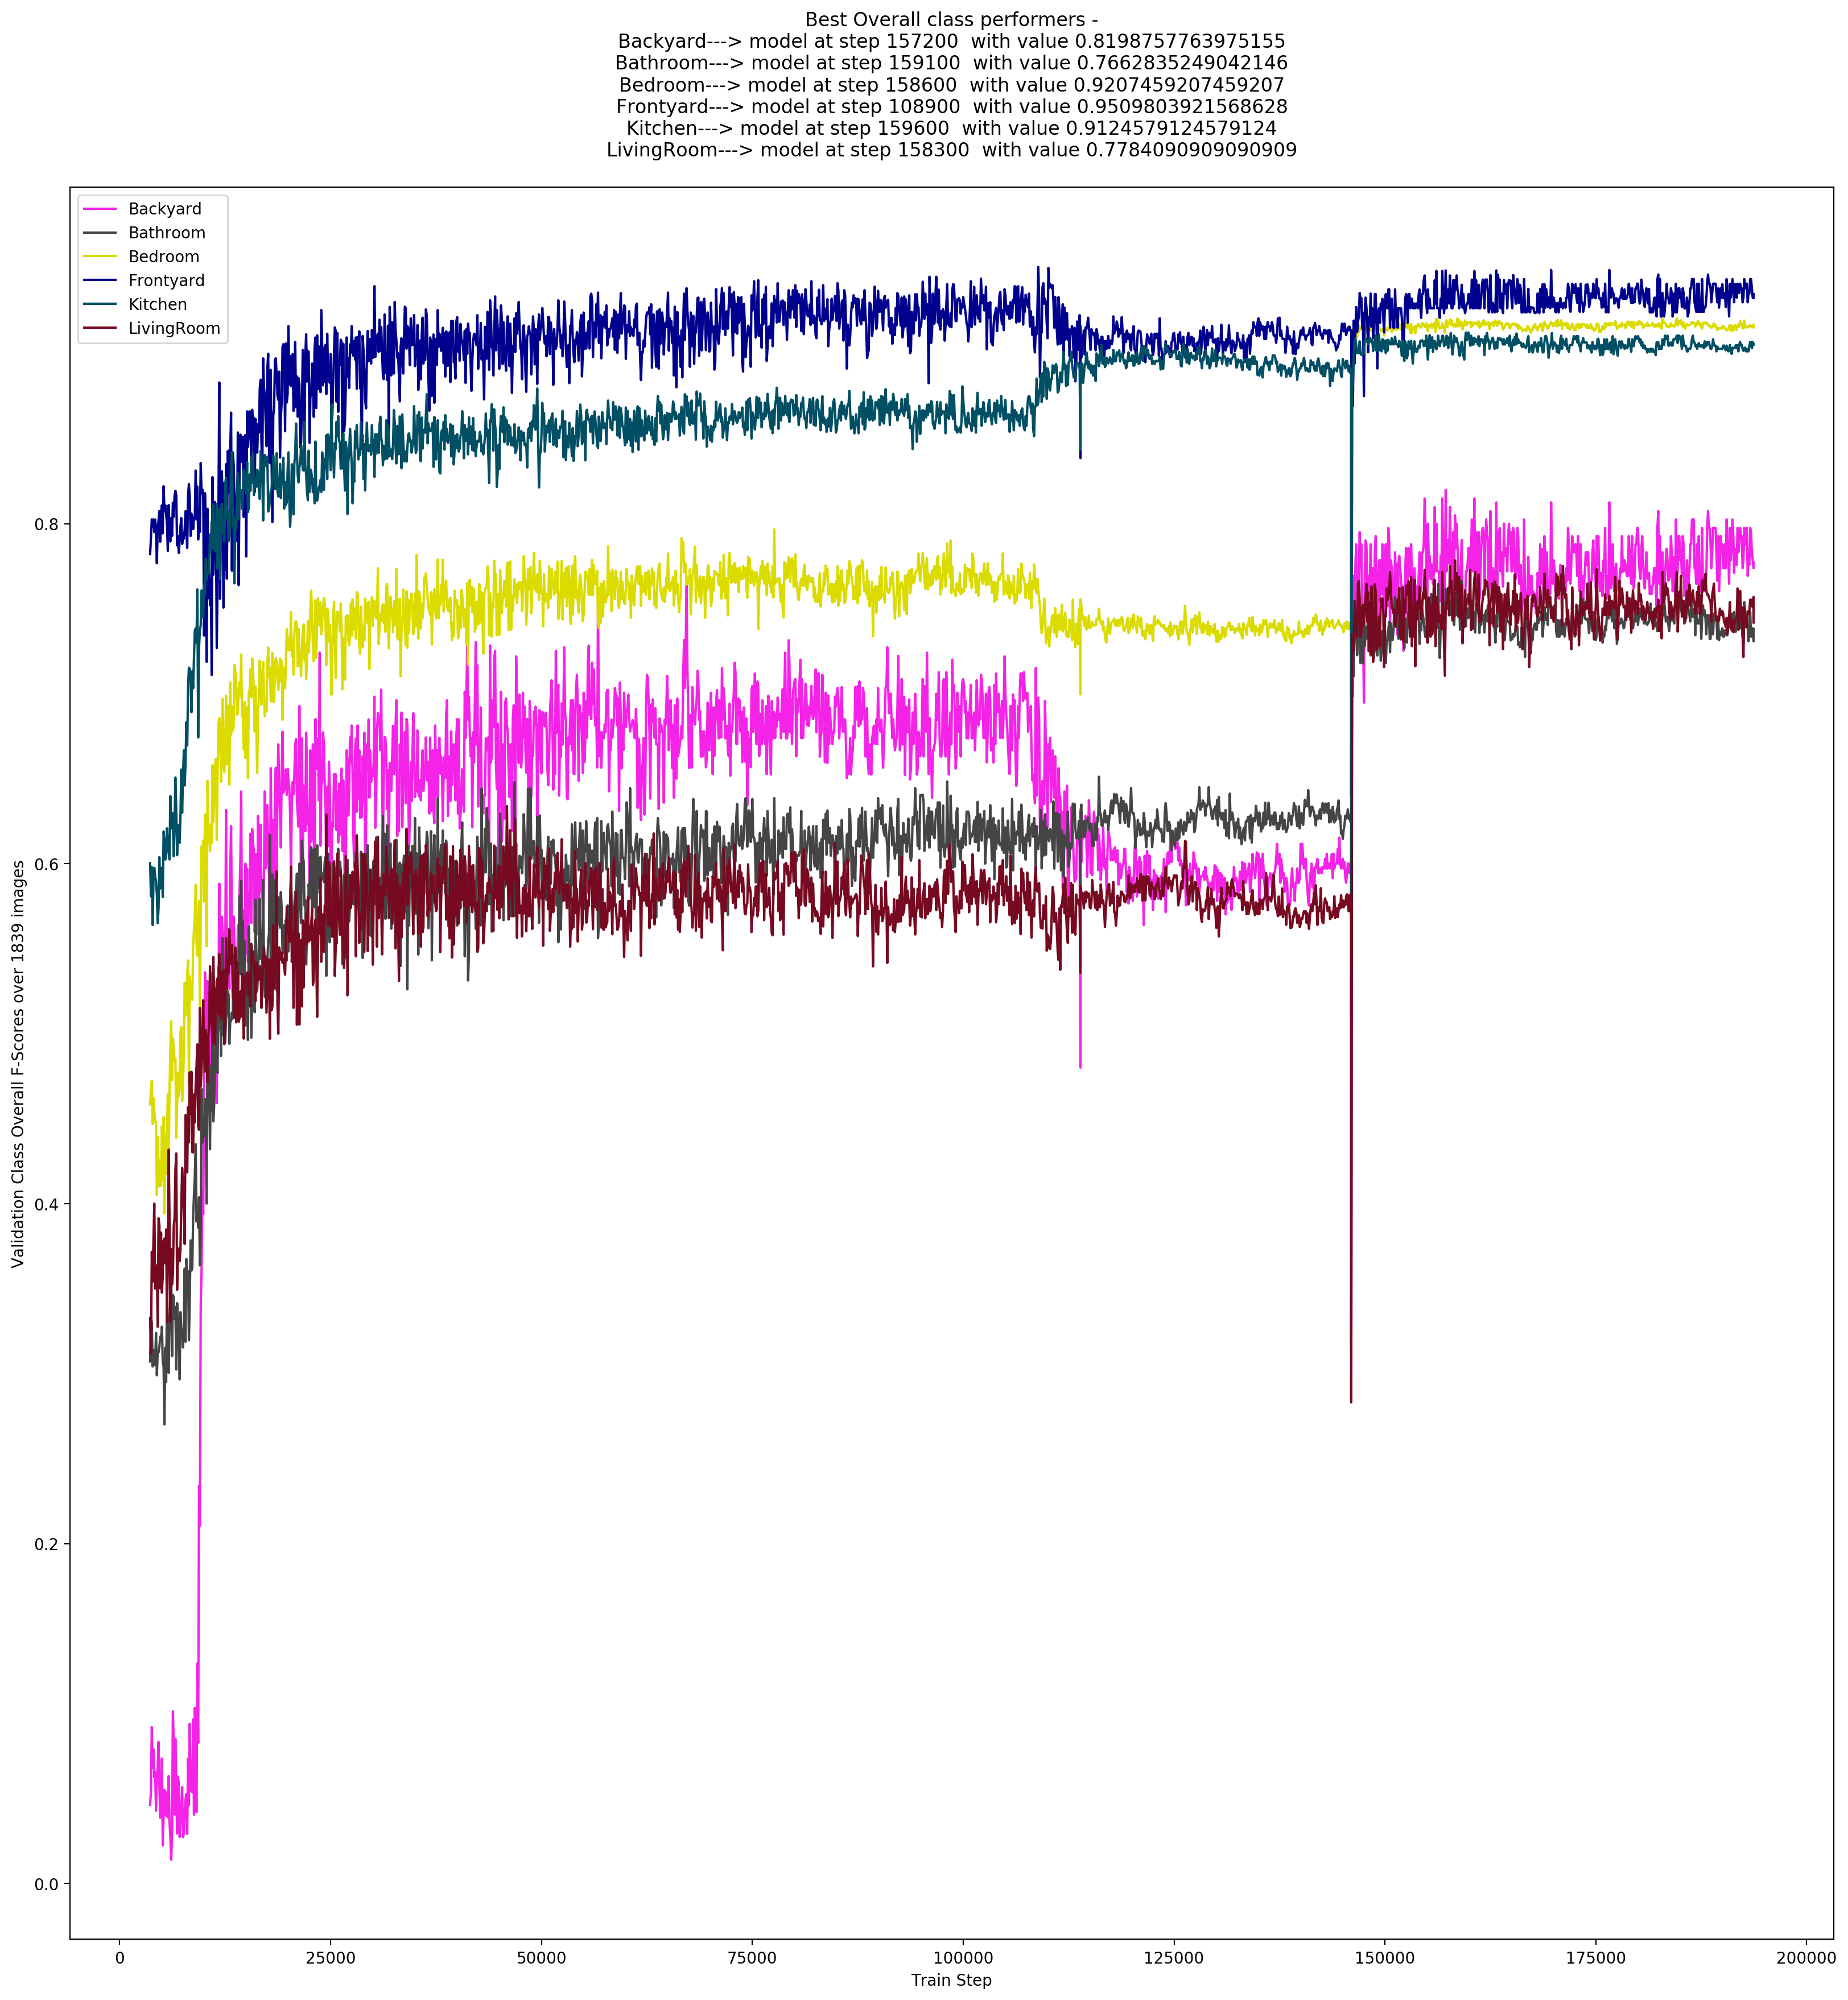
Class-wise Validation F-Score Plot

Slide 7
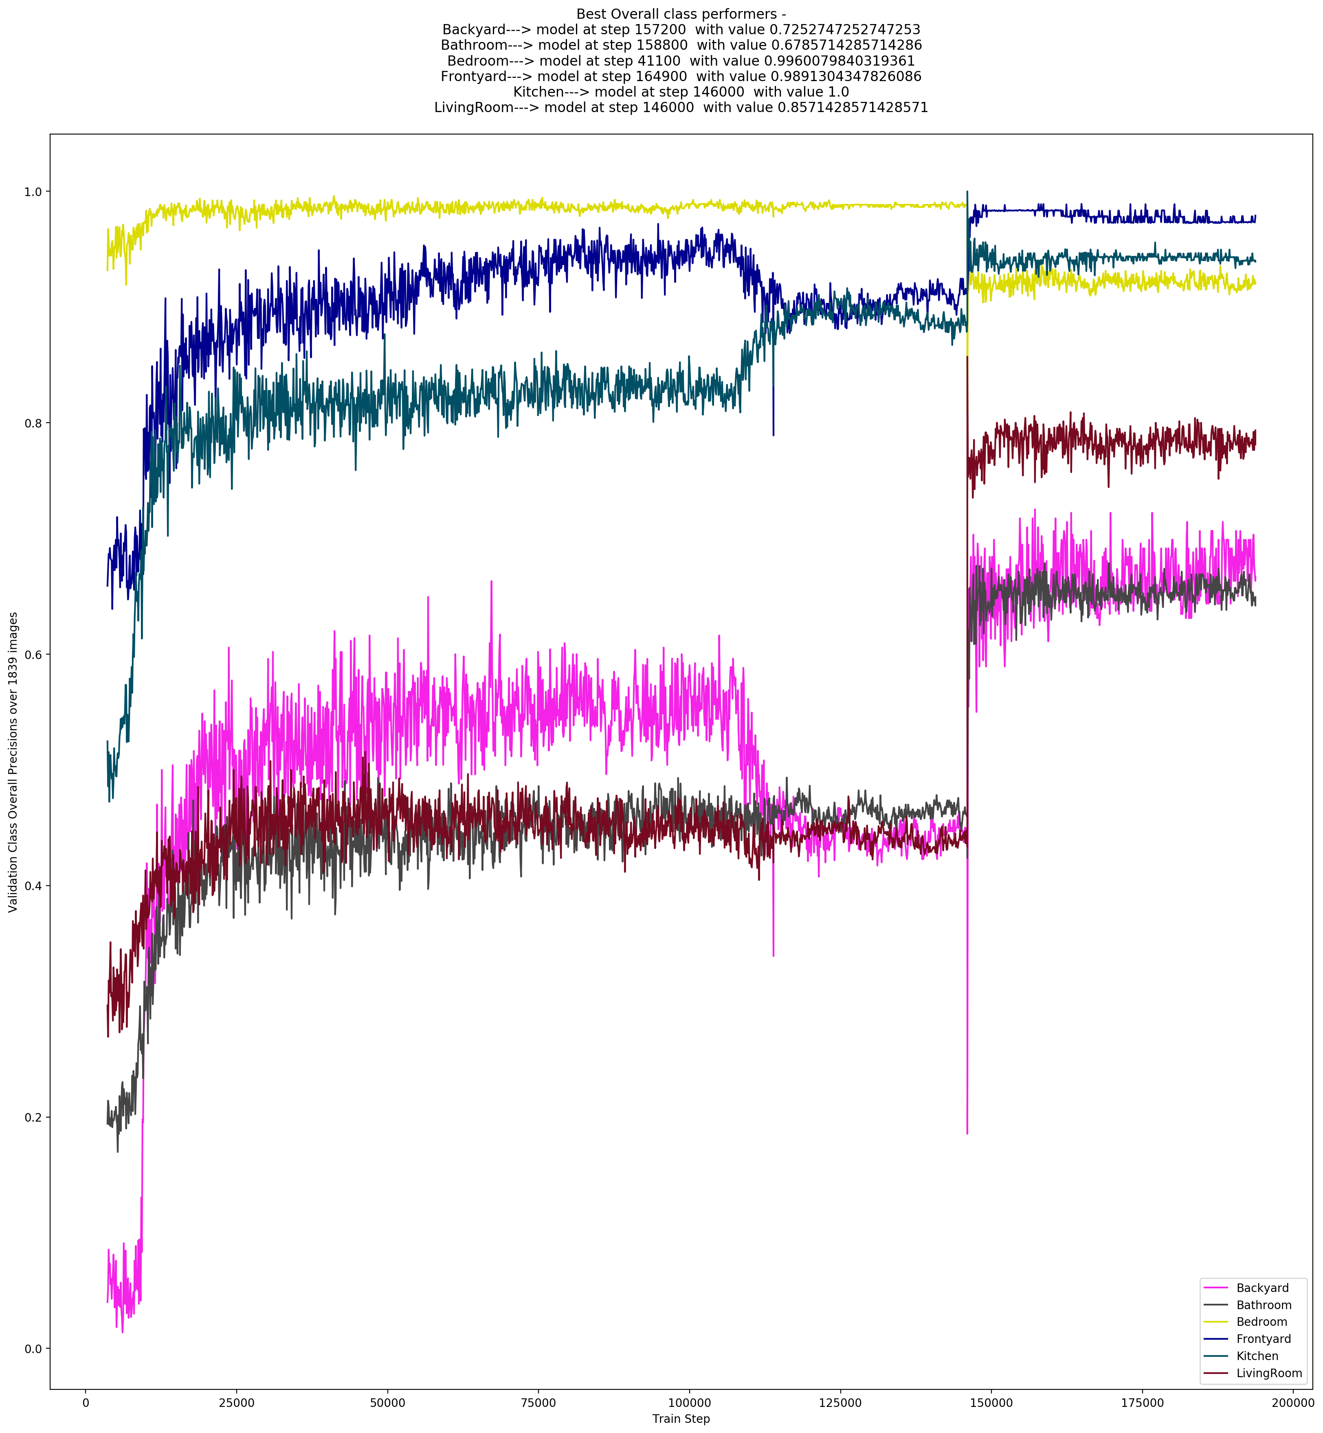
Class-wise Validation Precision Plot

